Slide 1

Designing a Scalable Online Shopping System – Object Oriented Approach and UML modeling
Supervisor CSE-Students
Ms. B Malarvizhi D V Sai kumar-192372321
Ms. B Abisha G Venkatesh Reddy-192372262
Department of CSE Department of CSE
Saveetha School of Engineering Saveetha School of Engineering
Notes:
1
1

Slide 2
Introduction
Object-Oriented Online Shopping Platform for secure, scalable e-commerce
Key Modules: Product & Catalog Management, Order & Payment Processing
Core Features: Product Browsing, Order Placement, Secure Payments
OOAD Concepts: Encapsulation, Inheritance, Polymorphism applied
UML Modeling: Use Case & Class Diagrams for structured system design

Slide 3
Problem Statement
Traditional shopping lacks convenience, speed, and accessibility
Existing online systems face scalability and security challenges
Manual order and inventory handling cause delays and errors
Limited integration of payment and catalog management modules
Need for a flexible, object-oriented system to support future expansion

Slide 4
Literature Review
S.No | Author(s) & Year | Title / Source | Key Findings | Relevance to Project
1 | Brown, T. & Lewis, M. (2021) | The Role of Object-Oriented Analysis and Design in Scalable E-Commerce Systems – Journal of Software Engineering Practices | Emphasized using OOAD principles (encapsulation, inheritance, polymorphism) for modular and scalable online platforms. | Forms the conceptual foundation for applying OOAD in system design.
2 | Johnson, R. & Patel, S. (2020) | Implementing Object-Oriented Design for a Scalable Online Shopping System – IEEE Conference on OOAD & E-Commerce | Demonstrated UML diagrams for defining user interactions and improving maintainability. | Supports use of UML Use Case and Class Diagrams in this project.
3 | Sommerville, I. (2011) | OOAD Principles – Addison-Wesley | Provided fundamental object-oriented design principles and system modeling techniques. | Offers theoretical basis for object-oriented design structure.
4 | Kaur, N. & Singh, P. (2022) | Secure Online Payment Integration in E-Commerce Systems – International Journal of Computer Applications | Discussed encryption and secure payment gateway methods. | Guides secure payment processing module implementation.
5 | Wang, L. & Zhao, Y. (2023) | Scalable Product Catalog Management for Online Retail – ACM Digital Library | Proposed efficient catalog management with dynamic updates and search optimization. | Helps design the Product & Catalog Management Module.

Slide 5
Modules
Module 1 :- Product and Catalog Management Module.
Module 2 :- Order and Payment Processing Module.

Slide 6
Module 1: Product & Catalog Management Module
Purpose: To help administrators and sellers efficiently manage product information and categories.
Main Functions:
Add, edit, and delete products (CRUD operations).
Manage product categories, brands, and stock levels.
Upload and manage product images, prices, and descriptions.
Handle inventory updates automatically after purchases.
Search and filter products using keywords, price range, or category.
Maintain version control for product details (encapsulation used to secure product data).
OOAD Concepts:
Encapsulation: Secure product data in objects.
Inheritance: Base class “Product” → subclasses like “Electronics,” “Clothing,” etc.
Polymorphism: Display and sort different product types dynamically.

Slide 7
Module 1 – Product & Catalog Management
🔸 Use Case Diagram Components
Actors:
Admin / Sales Representative
Customer
Use Cases:
Add / Edit / Delete Products
View Product Catalog
Search / Filter Products
Update Inventory
🔸Class Diagram Components
Main Classes:
Product
Catalog
Admin / SalesRepresentative
Customer (for browsing)
Relationships:
Catalog contains multiple Product objects
Admin manages Catalog
Customer views Catalog

Slide 8
Module 2: Order & Payment Processing Module
Purpose: To handle order placement, payment, and order tracking in a secure, efficient manner.
Main Functions:
Generate unique order IDs for each purchase.
Update order status (Pending → Confirmed → Shipped → Delivered).
Integrate multiple payment methods (Credit/Debit card, UPI, Wallet, etc.).
Process refunds and cancellations automatically.
Encrypt payment information using secure protocols.
Allow customers to view order history and invoices.
Notify customers via email/SMS after successful payment.
OOAD Concepts:
Polymorphism: Different payment methods via a common “Payment” interface.
Encapsulation: Protect user and payment details.
Abstraction: Simplify complex payment gateway operations.

Slide 9
Module 2 – Order & Payment Processing
🔸 Use Case Diagram Components
Actors:
Customer
Sales Representative
Payment Gateway
Use Cases:
Place Order
Process Payment
Track Order
Issue Refund / Cancellation
🔸 Class Diagram Components
Main Classes:
Order
Payment
Customer
SalesRepresentative
Relationships:
Customer places Order
Order uses Payment
SalesRepresentative updates Order status

Slide 10
EXISTING METHODS AND PROPOSED STRUCTURED METHODS
Module | Topic | Existing Method | Proposed Structured Method
Module 1: Product & Catalog Management | Product creation and listing | Manual product updates, limited search and filtering | Automated catalog management with search, category filter, and stock tracking
Module 2: Order & Payment Processing | Order handling and payment | Separate systems for orders and payments | Integrated order and payment module with secure transaction flow

Slide 11
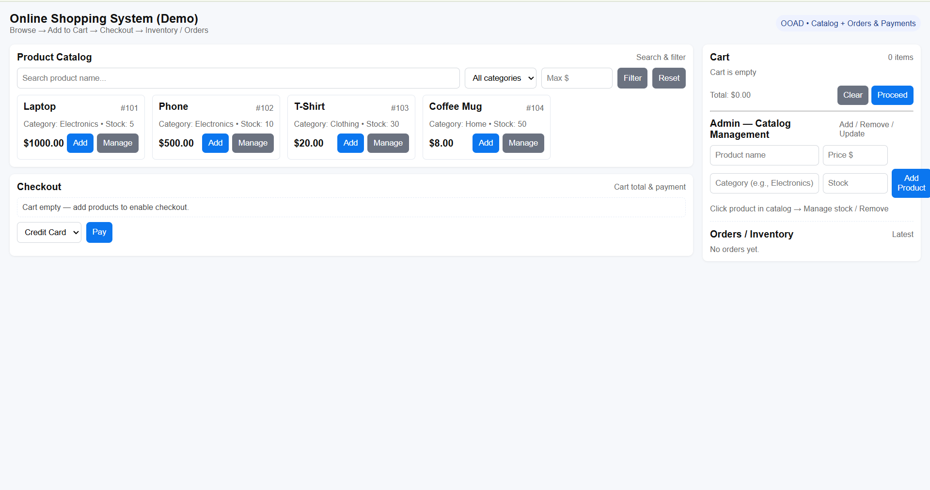
Visual Output

Slide 12
CONCLUSION
Developed a scalable and efficient online shopping platform using OOAD principles.
Ensured secure and structured management of products, orders, and payments.
Designed with UML models for clear visualization of system interactions and architecture.
Built a future-ready system capable of easy integration, maintenance, and expansion.

Slide 13
References
Sommerville, I. (2011). Object-Oriented Analysis and Design Principles (9th ed.). Addison-Wesley.
Brown, T., & Lewis, M. (2021). The Role of OOAD in Scalable E-Commerce Systems. Journal of Software Engineering Practices, 42(3), 78–92.
Johnson, R., & Patel, S. (2020). Implementing Object-Oriented Design for a Scalable Online Shopping System. IEEE Conference on OOAD & E-Commerce.
Kaur, N., & Singh, P. (2022). Secure Online Payment Integration in E-Commerce Systems. International Journal of Computer Applications.
Wang, L., & Zhao, Y. (2023). Scalable Product Catalog Management for Online Retail. ACM Digital Library.

Slide 14


